Slide 1
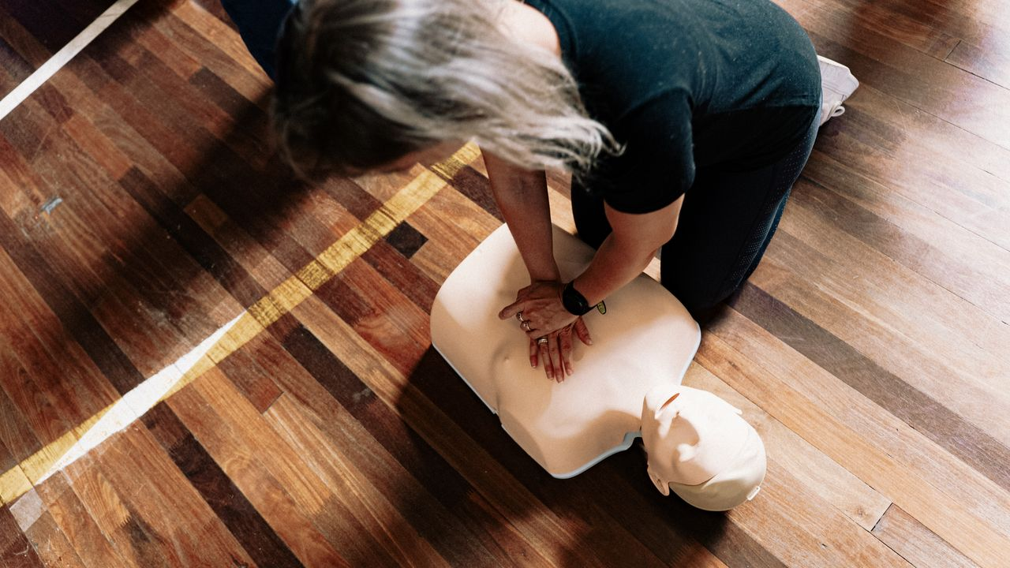
CPR: You Could
Save a Life
Grades 7–9
Together For Health

Slide 2
9 in 10
cardiac arrests that happen outside hospital occur before paramedics arrive
Immediate bystander CPR can double or triple survival rates. The first 4 minutes are critical.
Together For Health

Slide 3
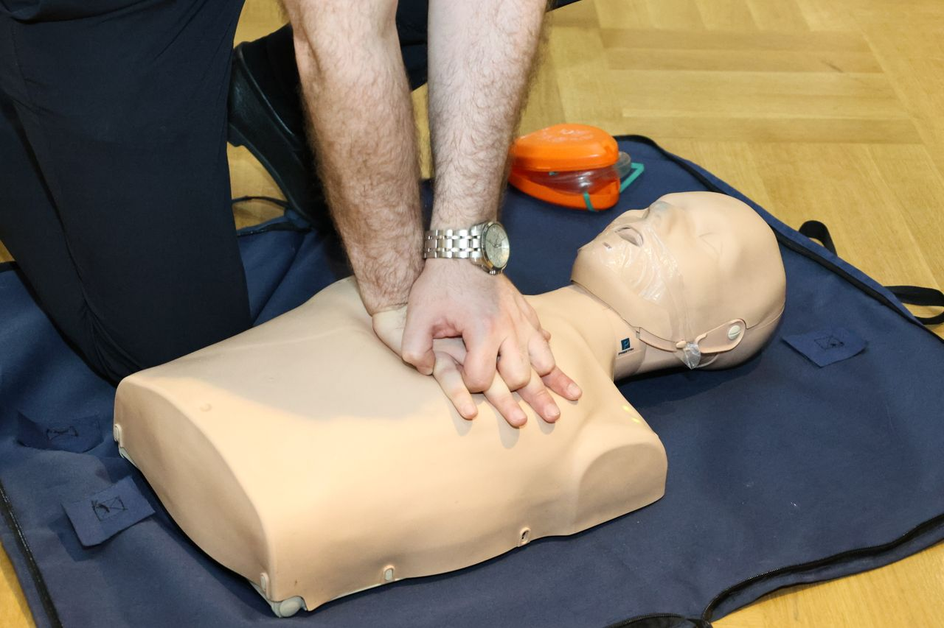
🔬
What Happens During Cardiac Arrest?
Heart stops pumping blood effectively — often due to ventricular fibrillation
Brain cells begin dying within 4–6 minutes without oxygen
CPR maintains ~20–30% of normal blood flow to vital organs
Each minute without CPR: survival drops 7–10%
CPR + early defibrillation (AED): 3–4× higher survival rate
Together For Health

Slide 4
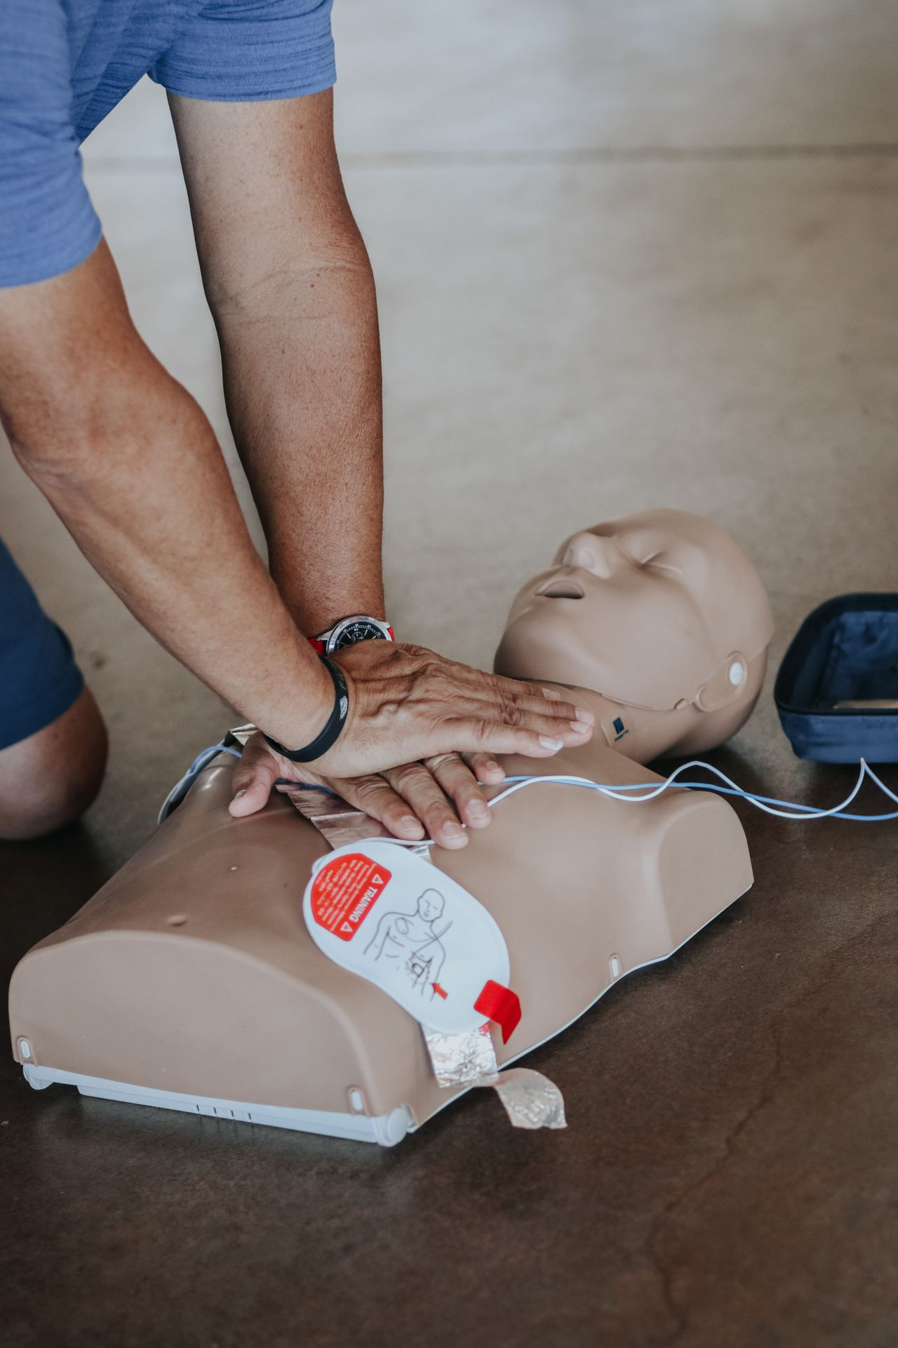
🆘
The Full C-A-B Protocol
CHECK the scene: is it safe? Check for responsiveness — "Are you okay?"
1
CALL 9-1-1 — do this first, or have someone else do it while you start CPR
2
COMPRESSIONS: 30 chest compressions at 5–6 cm depth, 100–120 bpm
3
AIRWAY: tilt head back, lift chin — open the airway
4
BREATHING: 2 rescue breaths (optional — hands-only is also effective)
5
Together For Health

Slide 5
⚡
AED — Automated External Defibrillator
AEDs are in most public buildings, schools, and arenas
The machine talks you through every step — designed for untrained users
Shocks the heart to restore normal rhythm
Turn it on → follow instructions → apply pads → press shock if advised
Resume CPR immediately after shock — do not stop
Together For Health

Slide 6
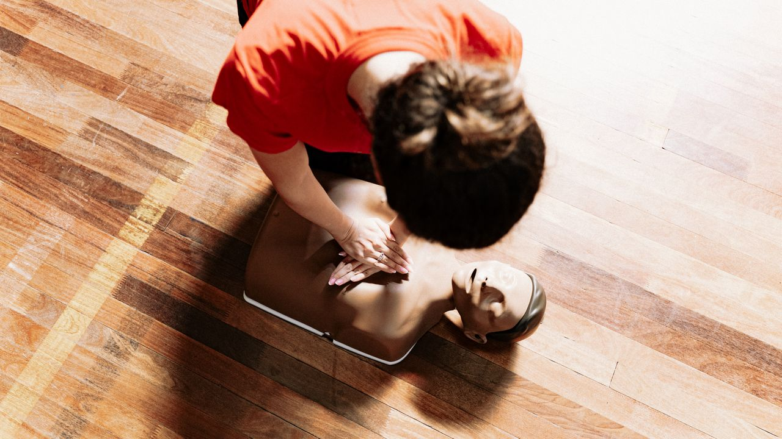
⏱️
Time Is Everything
For every 1 minute without CPR and defibrillation, survival decreases by 10%.
After 10 minutes without CPR, survival is extremely rare. You are the first link in the chain of survival.
Together For Health

Slide 7
KEY TAKEAWAYS
Calling 9-1-1 and starting CPR immediately saves lives
✓
Hands-only CPR is effective — no excuses not to start
✓
Get certified — 2 hours of training can save someone's life
✓
Resources
St. John Ambulance: sja.ca/cpr
Heart & Stroke: heartandstroke.ca
Red Cross: redcross.ca/firstaid
Together For Health

